Slide 1

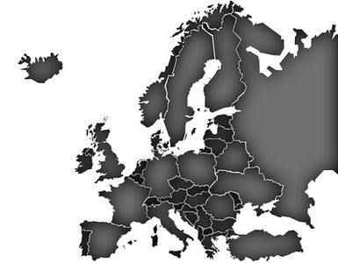

Do we have the capabilities needed to deal with the risks we are facing?
Capability Assessment
The Swedish Experience
Kristin Jacobsson and Maria Wahlberg, MSB
From Gaps to Caps, Kick-off Conference 24-25 March 2015

Slide 2

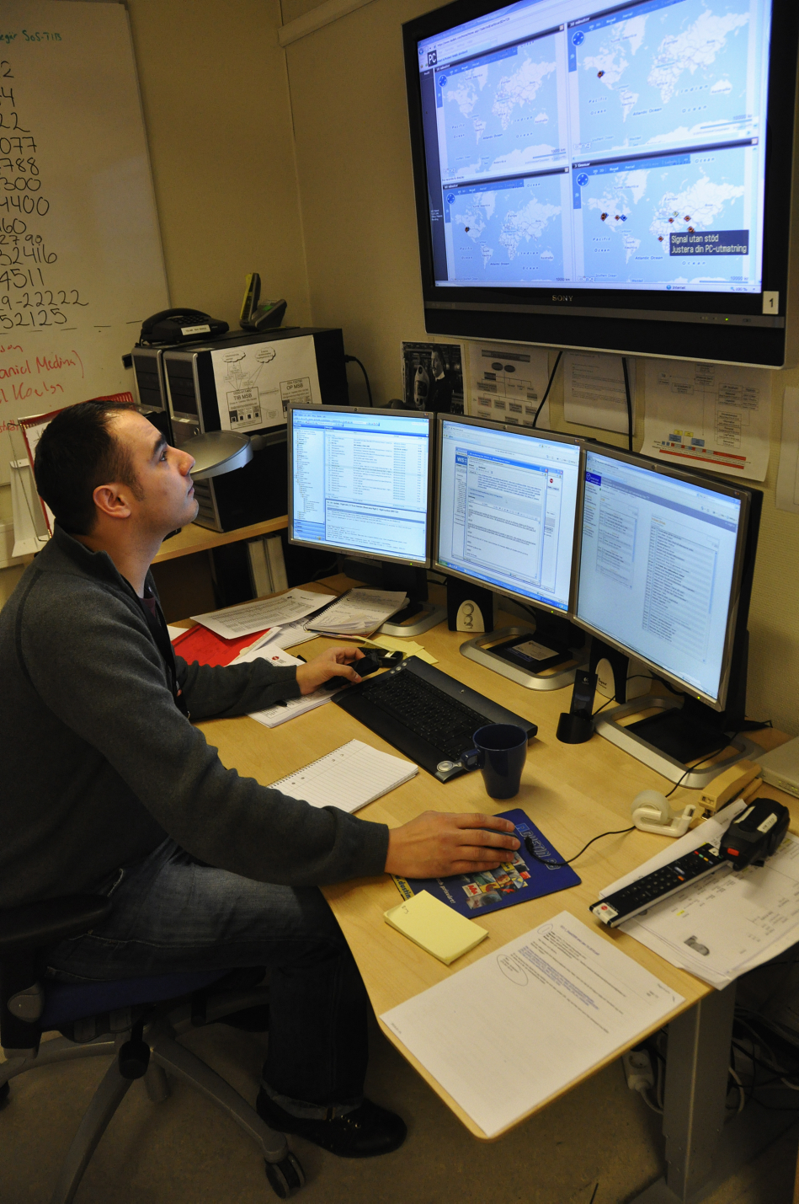
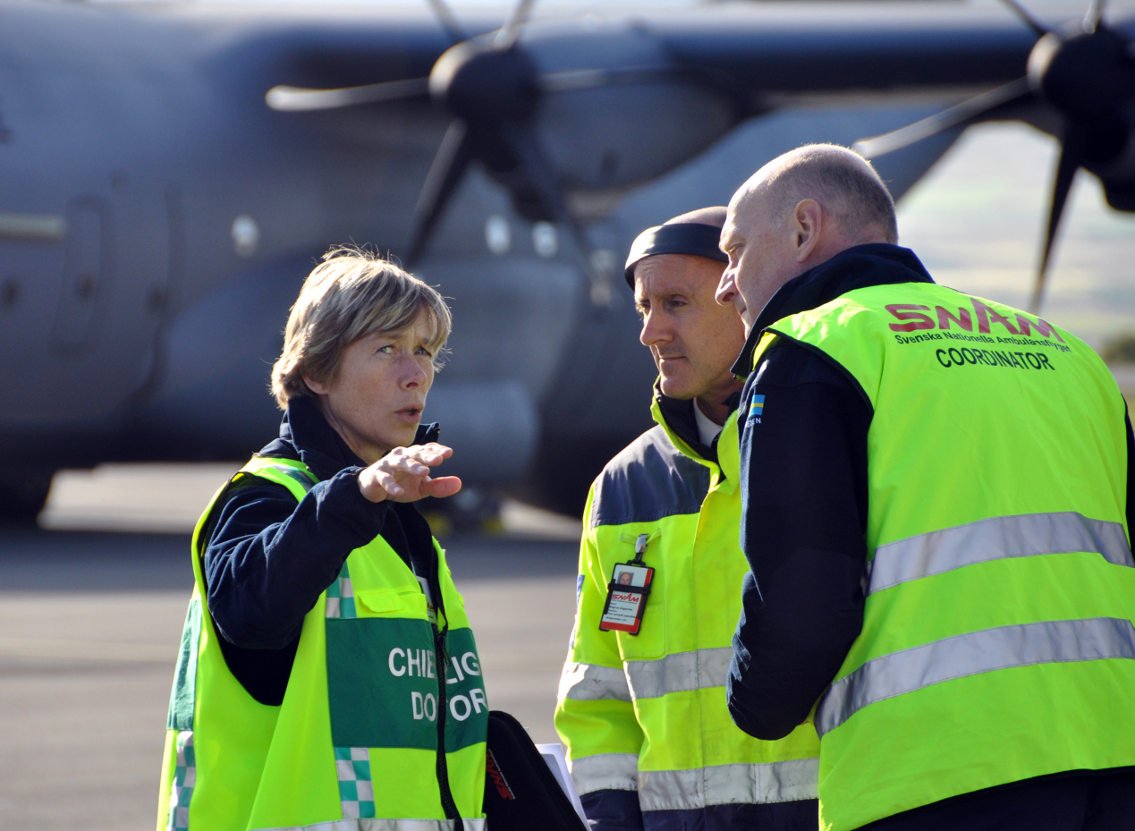
National capability assessment:
Assessment of the capability to prevent and respond to emergencies, crises and war
Purpose: to identify gaps in order to focus development efforts and prioritize resources

Slide 3
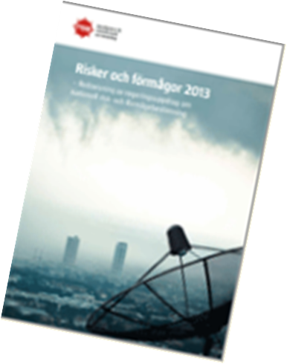
National Capability assessments have been carried out…
and reported to the government,
by MSB and its predecessors (KBM, ÖCB),
using different methods,
almost every year since the 1990:s.
The capability assessment is currently under development to be merged with the Swedish National Risk Assessment, (NRA)

Slide 4
Capability assessments – experience so far…
Require a framework to:
Describe capabilities, (e.g. in terms of communication, resources, cooperation etc.)
Set targets for the capabilities to reach (What constitutes a “good enough” capability?)
Assess the status of the capabilities in a common/standardized way, for example by the use of indicators
Capability assessments without reference to particular
risk scenarios tend to be broad and overly optimistic

Slide 5
Capability assessments – experience so far…
Sources of information to use in assessments:
“Risk and vulnerability analyses” by government agencies, regional and local authorities - including a generic Capability Assessment based on indicators
Scenario based workshops/interviews with experts
Evaluations of the emergency management system’s performance during exercises and real events.
Other…

Slide 6
Background National Risk Assessment (NRA) in Sweden
EU KOM invited MS to report NRA in 2011
MSB started the development of a process/methodology for NRA
MSB has reported to the government in:
  March 2013
  March 2014
  March 2015
MSB will provide the government with material for Sweden´s NRA which will be reported to the EU KOM in December 2015

Slide 7
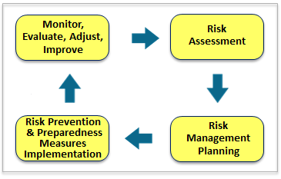
The NRA 2011-2014, part of the Risk Management Cycle
Established a process/
methodology
identified 200 potential risks
deemed 27 of these to be
particularly serious (national) events
analyzed risks (probability and consequences) through 14 scenarios.

Slide 8
Capability Assessment in the NRA – towards a National Risk and Capability Analysis (NRCA)
One step missing between the NRA and the RM planning
Since 2013 we are working on combining Capability Assessment with the NRA.
Do we have what it takes to prevent, prepare and manage the scenarios in the NRA?

Slide 9
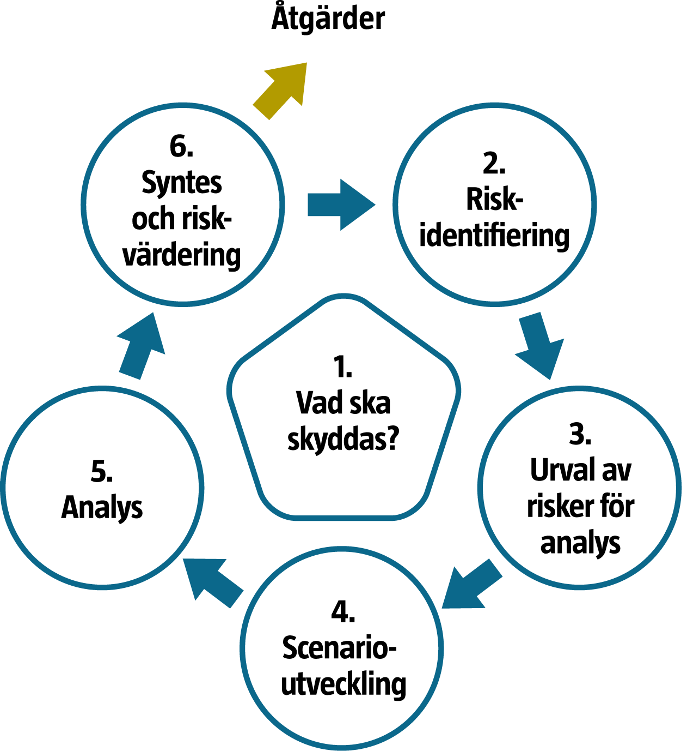
Capability Analysis linked to NRA
Scenario based
1. Capabilities needed?
2. Existing capability?
3. Capability Gaps?
4. Level of capability?
5 Input to RM planning
Analysis
incl. Scenario development
CAPABILITY Analysis
National Values of Protection
Risk Selection
Risk Identification

Slide 10
∞
Vision
Proposals for measures
to enhance capabilities
Scenario-based risk- &
capability assessment
Capability assessment of other sources
National
all-hazard capability assessment
Analysis
incl. Scenario development
Capability Analysis
Analysis real life-experience
National Values of Protection
Analysis other sources
Risk Selection
Risk Identification
Analysis RVA by RM-actors

Slide 11
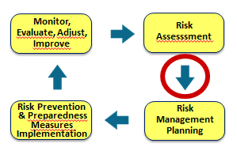


On Swedish capability assessment and the EU guidelines on Risk Management Capability assessment
EU guidelines concern the risk management process – are we assessing risks, planning and implementing measures in the best way possible?
Swedish/MSB capability assessment

Slide 12
Thank You!
For further info:
Maria Wahlberg
Kristin Jacobsson
MSB, Sweden
Maria.wahlberg@msb.se
Kristin.jacobsson@msb.se

