Slide 1
FROM GAPS TO CAPS - TASK B - Publicity
Anthony Jay, Head of Media & Communications
Council of the Baltic Sea States Secretariat
Project Kick-off Conference, 24 March 2015
Reykjavik, Iceland

Slide 2
FROM 14.3 TO GAPS TO CAPS

Slide 3
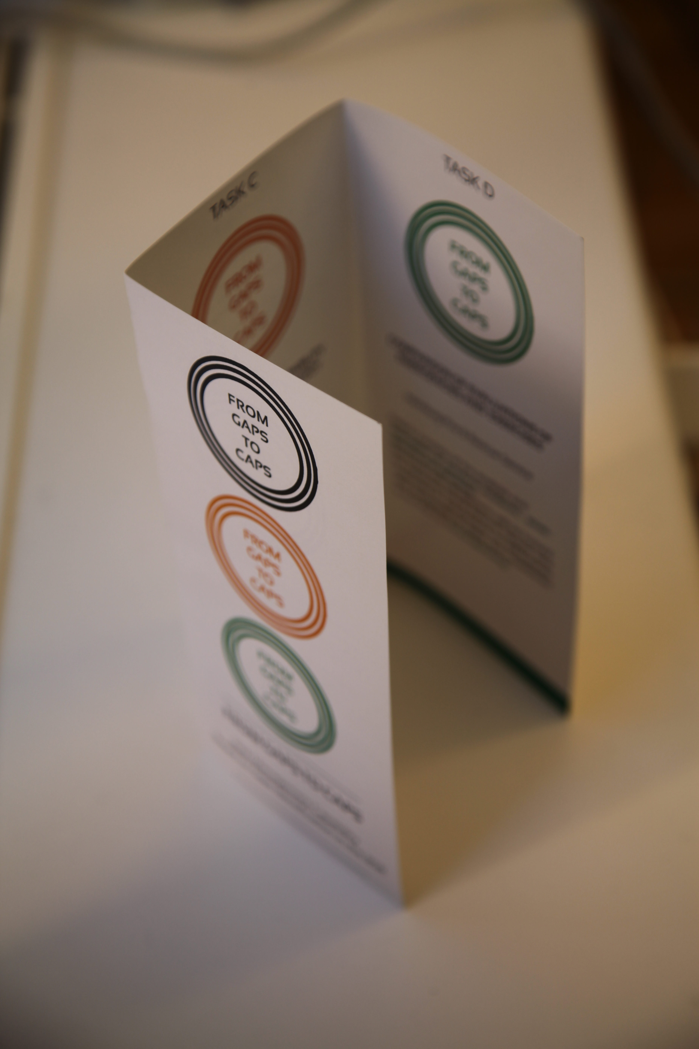
COMMUNICATIONS PLAN

Slide 4
Phase 1: Creation of an Image
Develop Communications Strategy
Create Visual Identity
Establish Online Presence
Phase 2: Ensure Visibility
Website/Social Media
Presentations
Leaflet
Phase 3: Preparing Material for High Level Events
Press-Kit
Quick Screens
Info Pack

Slide 5
Phase 4 & 5: Documentation & Updating
Phase 6: Final Project Steps
Final Projects Steps
Final Conference
Phase 7: Post-Communication
Dissemination
Develop platform of Prevention Strategies
Compile Beneficiary Report

Slide 6
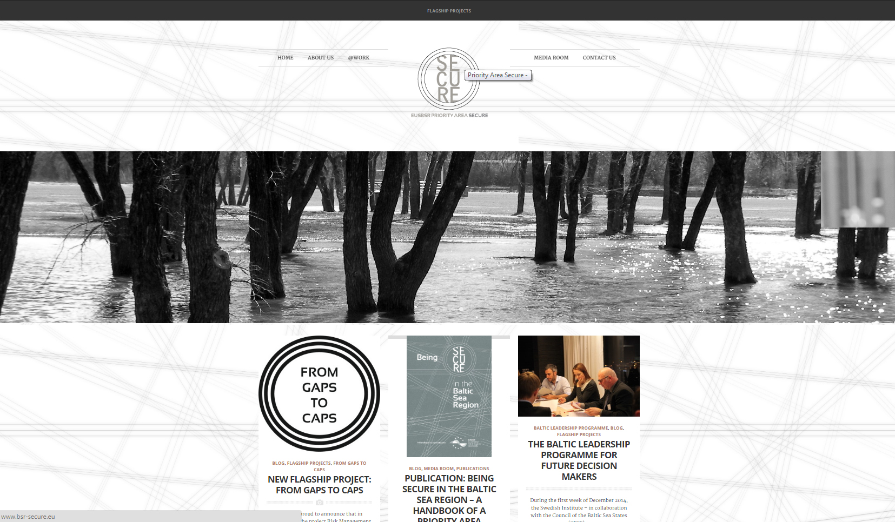
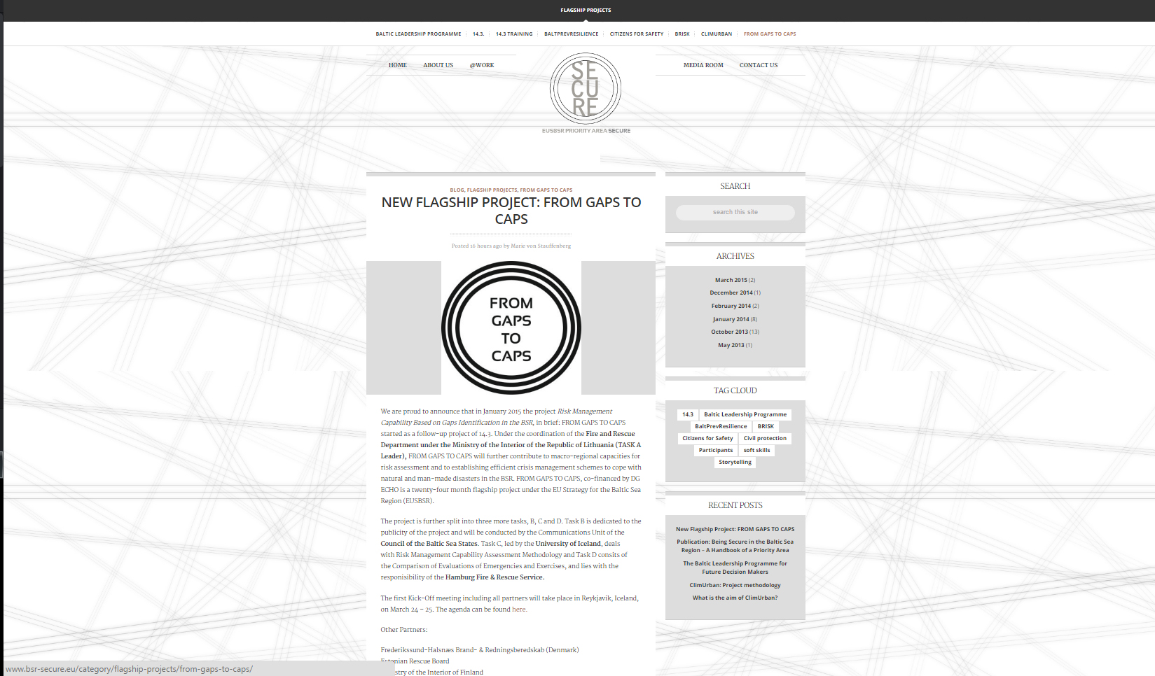
ONLINE PRESENCE

Slide 7
TASK C RISK MANAGEMENT CAPABILITY ASSESSMENT METHODOLOGY

Slide 8
TASK D– COMPARISON OF EVALUATIONS OF EMERGENCIES AND EXERCISES

Slide 9
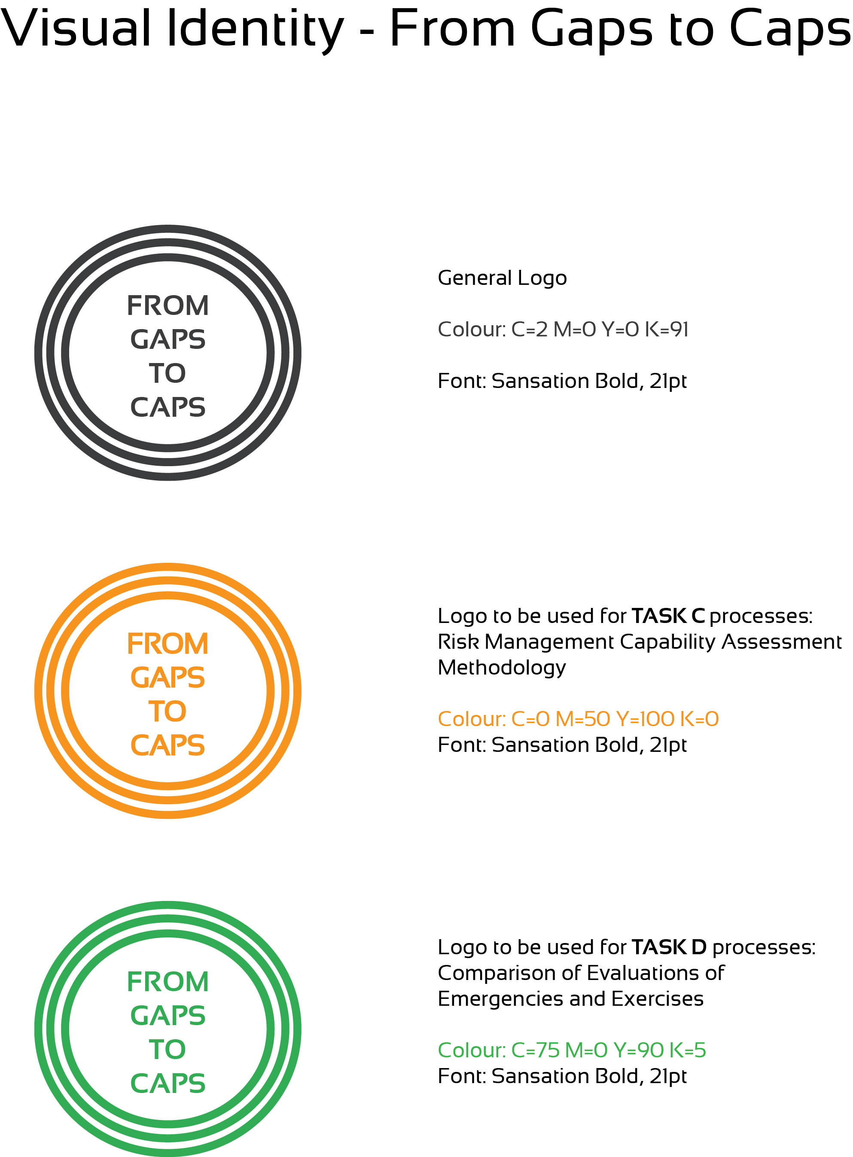

Slide 10
EXPECTED RESULTS
Enhanced capabilities of participating states for preparing and reviewing national capability assessments as well as national risk assessments for prevention.
Increased comparability between future national capability assessments around the BSR through the development of common frameworks and terminology for prevention.

Slide 11
EXPECTED RESULTS
Enhanced awareness of cross-border hazards among agencies responsible for national risk assessments and capability assessments in the BSR.
Enhanced awareness and understanding among the BSR states for the cross-border needs in case of complex emergencies
Enhanced preparedness among participating states for responding to complex emergencies

