Slide 1
Where is EU going?
Union Civil Protection Mechanism

Slide 2
The documents…..
Risk assessment and mapping guidelines 2010
New Union Civil Protection Mechanism 2013
Risk Management Capability Analysis – guidelines Jan. 2015
Guidelines Peer Review

Slide 3
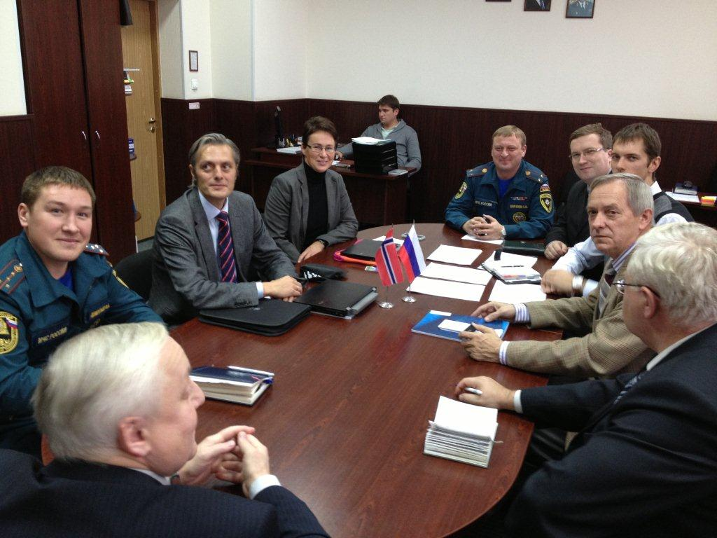
Why is this important?
It affects the analysis we do
We will have to report on this
Nobody is quite sure on how to do this
We like to do meaningful work

Slide 4
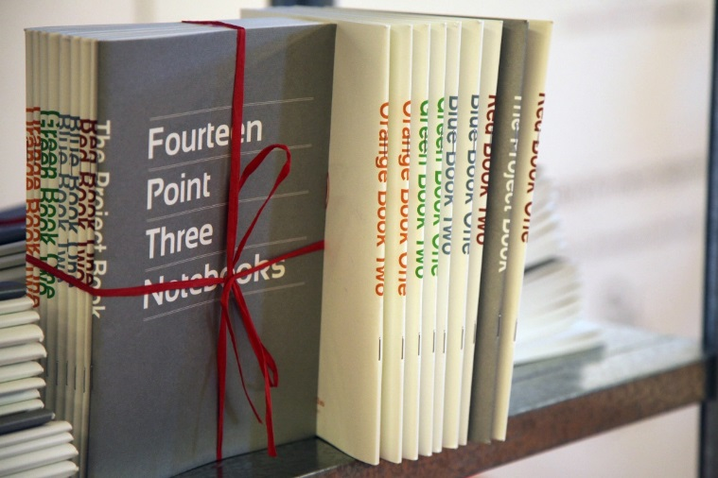
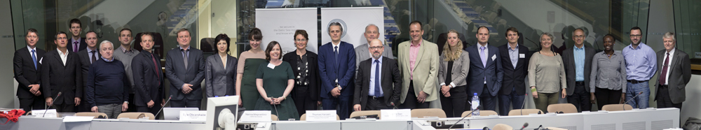
We have EU’s attention….
We tested their guidlines in a macro-regional context
We increased the activity and discussions
We attracted much attention in 14.3

Slide 5
EU Risk Assessment and Mapping Guidelines
The commission is called on, before the end of 2012, on the basis of national risk analysis, to prepare a cross-sectorial overview of major natural and man-made risks that the EU may face in the future.
An all-hazard approach to threat and risk assessment – based on a multi-hazard and multi-risk approach, covering in principle all natural and man-made disasters.
Establishing by 2014 a coherent risk management policy linking threat and risk assessments to decision making.

Slide 6
Objectives
Inform decisions on how to prioritise and allocate investments in prevention, preparedness and reconstruction measures;
Contribute to the raising of public awareness on disaster prevention measures;
Contribute to establish, by 2014, a coherent risk management policy linking threat and risk assessments to decision making, as stated in the recently adopted Communication from the Commission on the "EU Internal Security Strategy In Action: five steps towards a more secure Europe"

Slide 7
Union Civil Protection Mechanism

Slide 8
Definisjoner
Administrative capacity,
Technical capacity
Financial capacity
Disaster
Response
Preparedness
Prevention
Early warning
Module
Risk assessment
Risk management capability
Host nation support
Response capacity
Logistical support

Slide 9
Commitments
Article 6. Risk management
……Relevant parts of the National Risk Assessment sent to EU 22. December 2015 and every three years thereafter.
….Perform risk managment capability assessment and report every third year.
…..Participate – on vulontary basis – in peer review of risk management capability assessments.

Slide 10
Hvordan ser guidelines ut nå?
RMCA
Have removed the sections:
Administrative capacity,
Technical capacity og
Financial capacity
Now it is divided into:
Risk assessment
Risk management planning
Implementing risk prevention and preparedness measures
Still at toalt number of 51 questions!

Slide 11
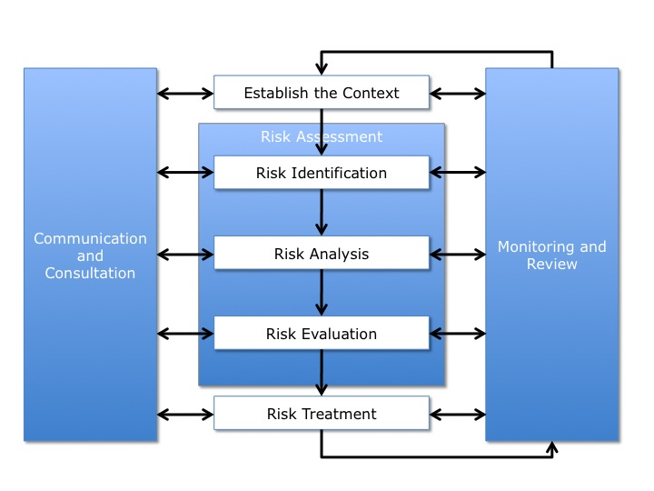
The traditional risk assessment

Slide 12
Risk assessment
Risk managment planning
Implementing risk prevention and preparedness measures
Capability assessment
Capability assessment
Capability assessment
Assessing the national system
Is there a framework in place?

Slide 15
From Gaps to Caps
Risk Management Capability Based on Gaps Identification in the BSR
This is where we come in and improve the world…..

Slide 16
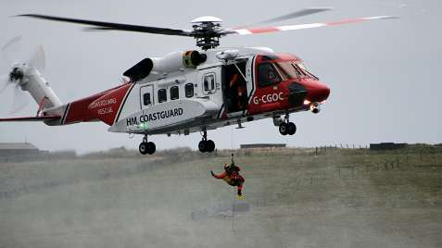
Capacity
Capability
Capability: A bucket can hold/contain water
Capacity: The bucket can hold 20 liters of water

